Slide 1
Network

Slide 2
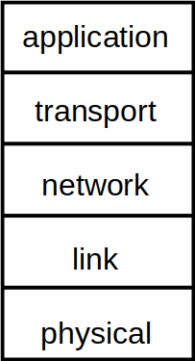
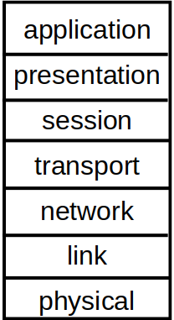
A little bit of academy
Message
Segment
Packet - Datagram
Frame
Bit
Notes:
application: supporting network applications
FTP, SMTP, HTTP
transport: process-process data transfer (Segmentation is here if requires)
TCP, UDP
network: routing of datagrams from source to destination
IP, routing protocols
link: data transfer between neighboring network elements
Ethernet, 802.111 (WiFi), PPP
physical: bits “on the wire”
—
presentation: allow applications to interpret meaning of data (Easily implemented in app layer)
e.g., encryption, compression, machine-specific conventions
session: synchronization, checkpointing, recovery of data exchange (mostly used in half-duplex links → in transport)

Slide 3

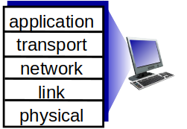




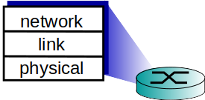
A little bit of academy
Source
Switch
Router
Destination
Switch

Slide 4
Dive in to Linux
IProute
IPtables

Slide 5
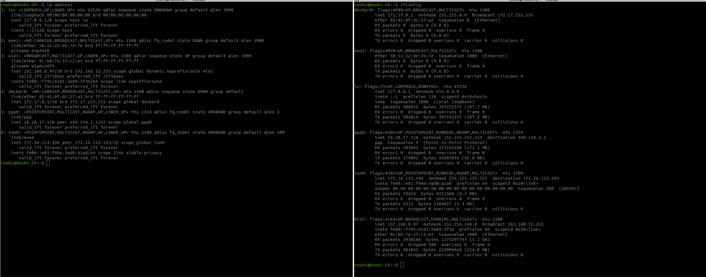
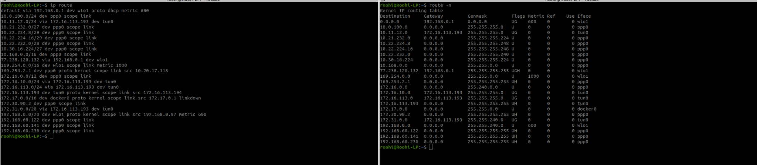
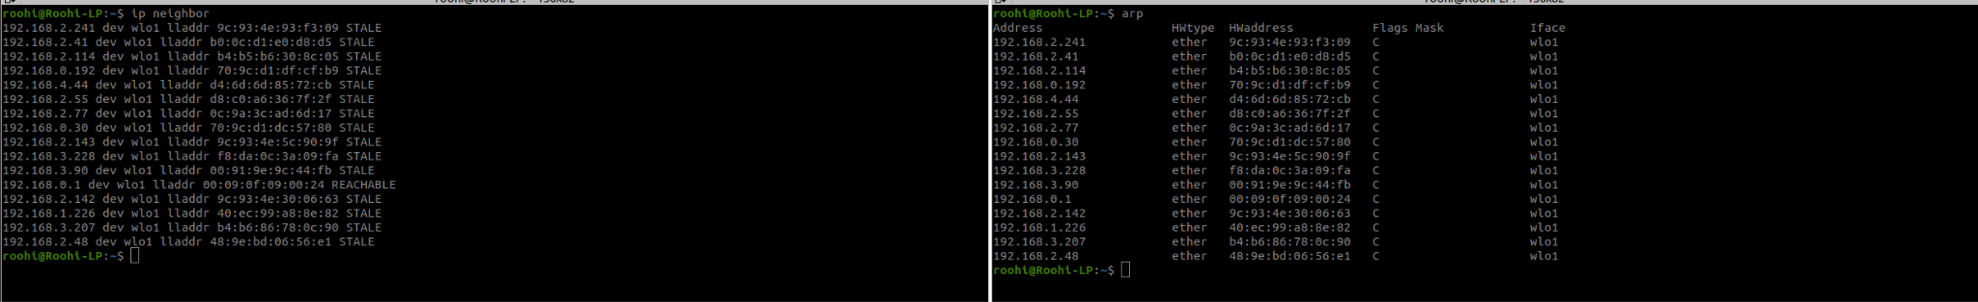
IProute
iproute = arp + ifconfig + route
Let’s go to terminal
Notes:
IPtables interact with netfilter

Slide 6
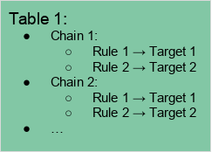
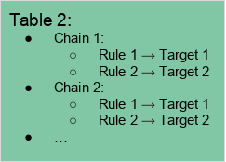

IPtables
Organized into:
Tables
Chains
Targets

Slide 7
IPtables
Chains:
Each of these tables are composed of a few default chains
These chains allow you to filter packets at various points
PREROUTING
INPUT
OUTPUT
FORWARD
POSTROUTING
Notes:
The PREROUTING chain: Rules in this chain apply to packets as they just arrive on the network interface. This chain is present in the nat, mangle and raw tables.
The INPUT chain: Rules in this chain apply to packets just before they’re given to a local process. This chain is present in the mangle and filter tables.
The OUTPUT chain: The rules here apply to packets just after they’ve been produced by a process. This chain is present in the raw, mangle, nat and filter tables.
The FORWARD chain: The rules here apply to any packets that are routed through the current host. This chain is only present in the mangle and filter tables.
The POSTROUTING chain: The rules in this chain apply to packets as they just leave the network interface. This chain is present in the nat and mangle tables.

Slide 8
IPtables
Tables:
A table is something that allows you to process packets in specific ways
The default table is the filter table, although there are other tables too:
Filter
Nat
Mangle
Raw
Some kernels: Security → SELinux
Notes:
The filter table: This is the default and perhaps the most widely used table. It is used to make decisions about whether a packet should be allowed to reach its destination.
The mangle table: This table allows you to alter packet headers in various ways, such as changing TTL values.
The nat table: This table allows you to route packets to different hosts on NAT (Network Address Translation) networks by changing the source and destination addresses of packets. It is often used to allow access to services that can’t be accessed directly, because they’re on a NAT network.
The raw table: iptables is a stateful firewall, which means that packets are inspected with respect to their “state”. (For example, a packet could be part of a new connection, or it could be part of an existing connection.) The raw table allows you to work with packets before the kernel starts tracking its state. In addition, you can also exempt certain packets from the state-tracking machinery.
In addition, some kernels also have a security table. It is used by SELinux to implement policies based on SELinux security contexts.

Slide 9
IPtables
PREROUTING
INPUT
Local Process
Network Interface
raw
mangle
nat
mangle
filter
Connection tracking
mangle
FORWARD
filter
Connection tracking
nat
mangle
filter
nat
mangle
raw
POSTROUTING
OUTPUT
Notes:
Incoming packets destined for the local system: PREROUTING -> INPUT
Incoming packets destined to another host: PREROUTING -> FORWARD -> POSTROUTING
Locally generated packets: OUTPUT -> POSTROUTING

Slide 10
IPtables
Targets:
Default policy
For each chain
Defined as a target
Types of targets:
Terminating
ACCEPT
DROP
REJECT
Non-Terminating
LOG
Let’s go to terminal
Notes:
Terminating: means that they decide the matched packet’s fate immediately. The packet won’t be matched against any other rules
ACCEPT: This causes iptables to accept the packet.
DROP: iptables drops the packet. To anyone trying to connect to your system, it would appear like the system didn’t even exist.
REJECT: iptables “rejects” the packet. It sends a “connection reset” packet in case of TCP, or a “destination host unreachable” packet in case of UDP or ICMP.
Non-Terminating: which keep matching other rules even if a match was found
LOG: When a matching packet is received, it logs about it in the kernel logs. However, iptables keeps matching it with rest of the rules too.

Slide 11
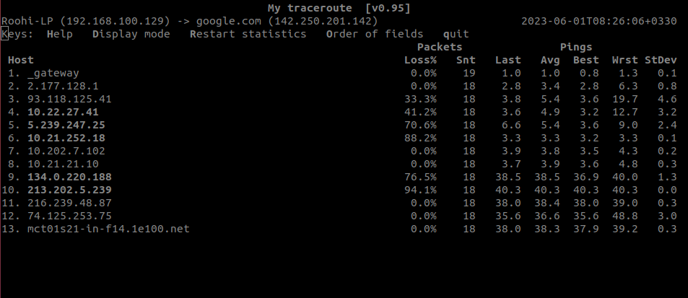
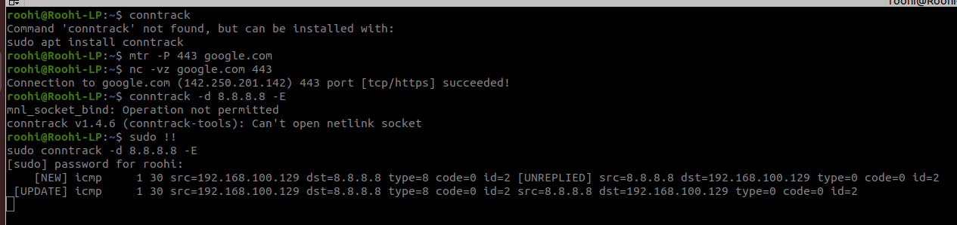
Useful Network Command
mtr
nc
conntrack
Notes:
Terminating: means that they decide the matched packet’s fate immediately. The packet won’t be matched against any other rules
ACCEPT: This causes iptables to accept the packet.
DROP: iptables drops the packet. To anyone trying to connect to your system, it would appear like the system didn’t even exist.
REJECT: iptables “rejects” the packet. It sends a “connection reset” packet in case of TCP, or a “destination host unreachable” packet in case of UDP or ICMP.
Non-Terminating: which keep matching other rules even if a match was found
LOG: When a matching packet is received, it logs about it in the kernel logs. However, iptables keeps matching it with rest of the rules too.

